Slide 1

Data Lake Value Proposition
Medical Data Processing Company
Nhan V. Nguyen
Udacity IPS Version 1.0

Slide 2
Agenda
What is a Data Lake
Components of a Data Lake
Data Lake vs Data Warehouse
Business Value of Data Lake Solution
Proposed Data Lake Architecture for Medical Data Processing system
Udacity IPS Ver. 1 2/2020

Slide 3
What is a Data Lake
Executive summary
The Data Lake serves as a centralized repository for all of a company's data objects. It accommodates various data formats and facilitates the provision of data to end users, including business analysts and data scientists.

Slide 4
Components of Data Lake
Ingestion: The initial point of entry for data.
Storage: The location where data is stored.
Processing: Where data undergoes processing.
Serving: The area where users access and utilize the data.
Security: Where controls and audits are implemented for data protection.
Scheduling: The mechanism responsible for orchestrating the flow of data.

Slide 5
Data Lake vs Data Warehouse

Slide 6
Data Warehouse
Data Lake
Structured Data Only: Utilize structured data exclusively.
Requires Processing: Data demands processing before use.
Predefined Data Knowledge: Understand the data beforehand.
Optimized for Queries: Optimize data for efficient querying.
Flexibility: Maintain adaptability.
Utilize Multiple Sources: Incorporate data from various origins.
Harness Machine Learning: Employ machine learning techniques.
Cost-Effective: Strive for affordability.
Udacity IPS Ver. 1 2/2020

Slide 7
Business Value of Data Lake
Eliminate Data Silos: Integrate data to eliminate isolated repositories.
Rapid Data Delivery: Ensure swift dissemination of data.
Utilize Advanced Capabilities: Employ capabilities like constructing Machine Learning models.
Near Real-Time Dashboards: Enable dashboards that provide nearly real-time insights.

Slide 8
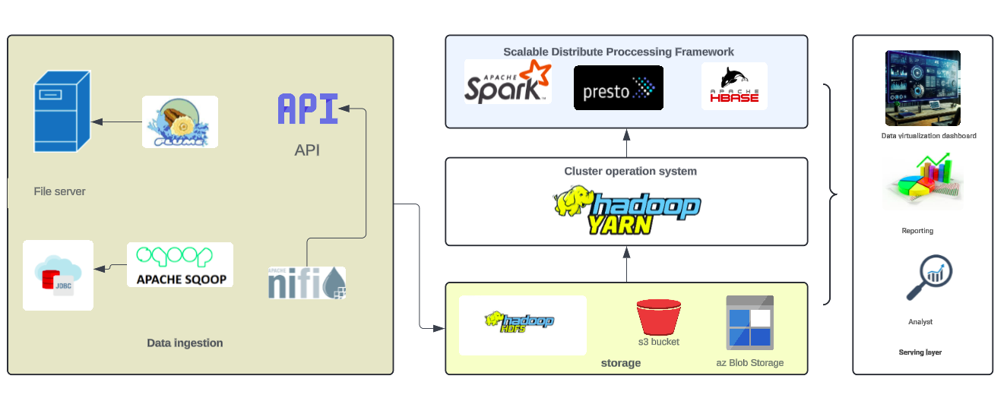
Data Lake Architecture

Slide 9
THANK YOU
Udacity IPS Version 1.0

